Slide 1
Introductory General Chemistry
Chemistry 3A
S. M. Halloran

Slide 2
Exam Protocol
Multiple-choice
25 or 30 questions (probably 30)
About 75 minutes
2.5-3 minutes per question (some easy, some difficult)
Three versions (shuffled questions) A, B, C
Record your version on your form
Scantron 95677
name
student ID
version: A, B, or C
No phones or other devices except approved calculator in hand. Zero on exam otherwise
For 75 min (5:00-6:15 pm), no going outside room
I will wander around room during exam

Slide 3
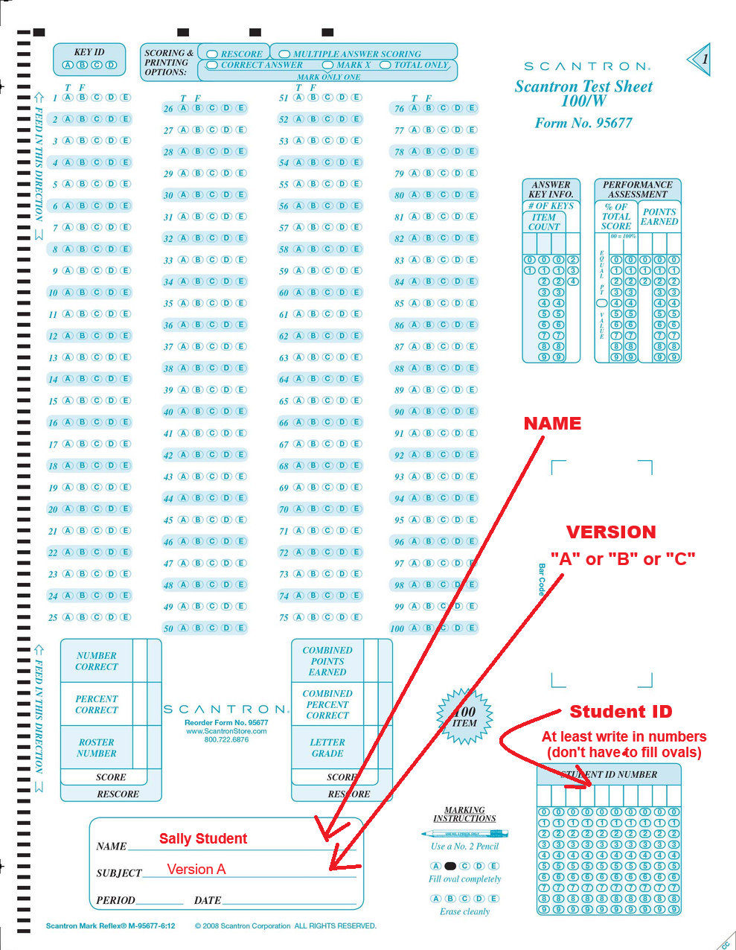
Scantron 95677

